Slide 1
Click on the slide show button or choose ‘View Show’ from the Slide Show Menu to start the presentation

Slide 2
The 5 minute template
Associated Web Resource:
Digital Presentations - A Manifesto
Click here to open your browser and view this file on the WEB

Slide 3
Templates: Are they important?
Definition:
Template, templet¹ (noun) - 1. A thin plate cut to the shape required, by which a surface of an article being made is marked out. 2. A device used in the creation of ornamental plasterwork.
Template, templet² (noun) - Any model from which others are formed or produced.
Notes:
Your choice of font will have a direct effect on your audience’s interest in your topic. Why make it hard for them to read, and for you to get your message across

Slide 4
Templates: are made of...
simple building blocks
a background
a colour scheme
a font scheme
a set of pre-defined page layouts incorporating content elements

Slide 5
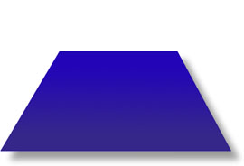

Templates: are made of...
simple building blocks
a background
a colour scheme
a font scheme
a set of pre-defined page layouts incorporating content elements

Slide 6
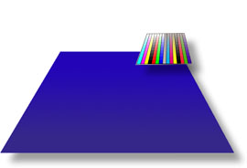
Templates: are made of...
simple building blocks
a background
a colour scheme
a font scheme
a set of pre-defined page layouts incorporating content elements

Slide 7
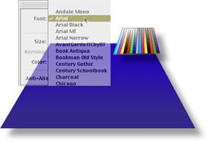
Templates: are made of...
simple building blocks
a background
a colour scheme
a font scheme
a set of pre-defined page layouts incorporating content elements

Slide 8
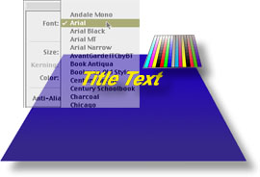
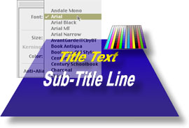
Templates: are made of...
simple building blocks
a background
a colour scheme
a font scheme
a set of pre-defined page layouts incorporating content elements

Slide 9
Templates: allow you to...
keep the visual appearance consistent
avoid ‘jumping’ text
use the same typeface throughout
choose custom backgrounds easily

Slide 10
Templates: be creative...
customise the look for each audience
for example...

Slide 11

Templates: be creative...
become familiar with the format menu...
this menu will speed customisation

Slide 12

Templates: be creative...
format - background...
allows individual custom backgrounds

Slide 13

Templates: be creative...
format - apply design...
overwrites one template with another

Slide 14
Templates: a final caveat...
avoid fun features - LASER TEXT
be aware of transitions & animations…
but use with caution…
they can be very irritating!
avoid using sound effects!

Slide 15
Simplicity creates visual clarity…
QUIT

